Slide 1
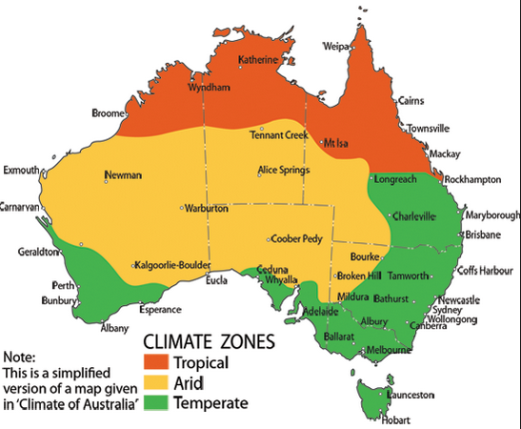

Slide 2
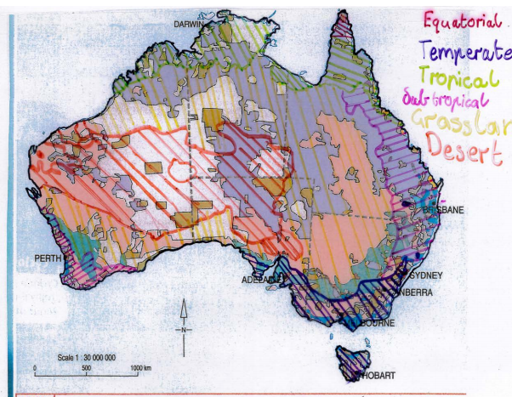

Slide 3
Land Use Paragraph Assessment
Write one great quality paragraph (5-6 sentences) about how land is used in Australia in relation to the climate in that part of the country.
Comment on what you notice about:
Land that is used for farming
Land that people choose to live on
Land that is not used at all
Where the tropical regions are located. Why do you think this is?

